Slide 1
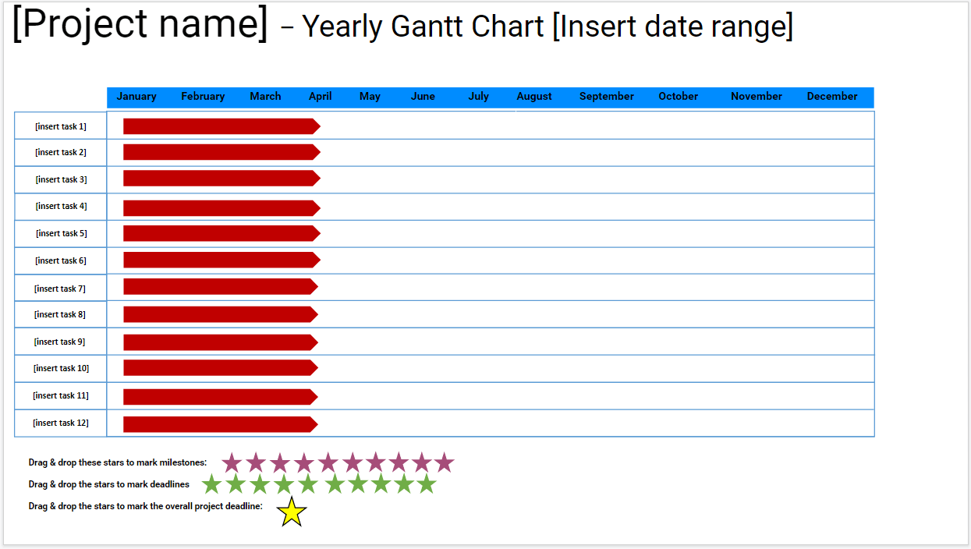
Instructions:
*READ THIS FIRST: Go to File, Make A Copy, and then fill out the template. Delete this message.
Add your project name
Define your tasks
TASKS:
Move the red arrow representing a task across its column, to mark its position on the chart (i.e. the time when you’ll tackle it)
Select and stretch the red arrow representing a task across its column, to mark its duration
MILESTONES:
To set a milestone, select a purple star, and drag & drop it to the desired month on the timeline
Add notes about the milestones below
DEADLINES:
To set a deadline, select a green star, and drag & drop it to the desired month on the timeline
Add notes about the tasks below
PROJECT DEADLINE:
To mark the project deadline, select the yellow star and drag & drop it to the desired month on the timeline
PRODUCTIVITY TIP:
Track time with Clockify.me, to improve the estimations you’ll make about task durations

Slide 2
[Project name] – Yearly Gantt Chart [Insert date range]
January February March April May June July August September October November December
[insert task 1]
[insert task 2]
[insert task 3]
[insert task 4]
[insert task 5]
[insert task 6]
[insert task 7]
[insert task 8]
[insert task 9]
[insert task 10]
[insert task 11]
[insert task 12]
Drag & drop these stars to mark milestones:
Drag & drop the stars to mark deadlines
Drag & drop the stars to mark the overall project deadline:

