Slide 1
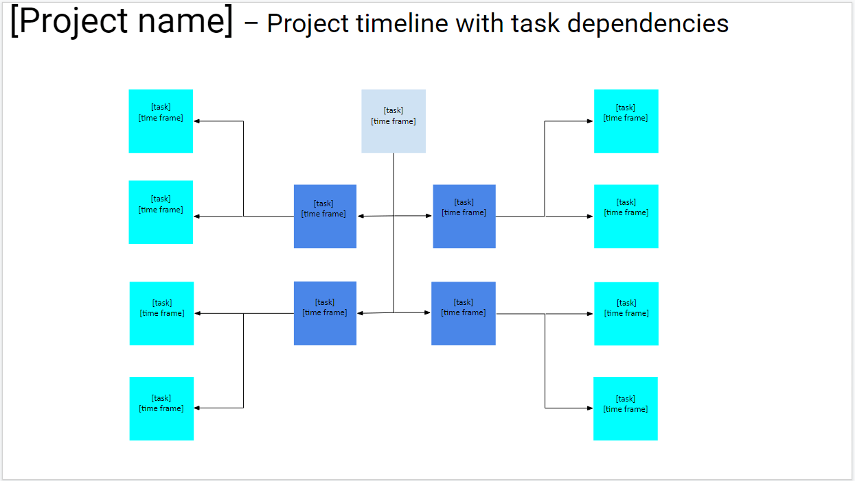
Instructions:
*READ THIS FIRST: Go to File, Make A Copy, and then fill out the template. Delete this message.
Add your project name
TASKS:
Add your main task into the gray square, and define the time frame when you’ll work on it (e.g. August 4th - August 10th; 9 am - 12 pm, August 10th).
Add the tasks directly related to the main task to the blue squares. Define the time frame when you’ll work on each.
All tasks related to the main task may have their own related tasks. Define their names and the time frame when you’ll work on each.
PRODUCTIVITY TIP:
Track time with Clockify.me, to improve the estimations you’ll make about task durations

Slide 2
[Project name] – Project timeline with task dependencies
[task]
[time frame]
[task]
[time frame]
[task]
[time frame]
[task]
[time frame]
[task]
[time frame]
[task]
[time frame]
[task]
[time frame]
[task]
[time frame]
[task]
[time frame]
[task]
[time frame]
[task]
[time frame]
[task]
[time frame]
[task]
[time frame]

