Slide 1
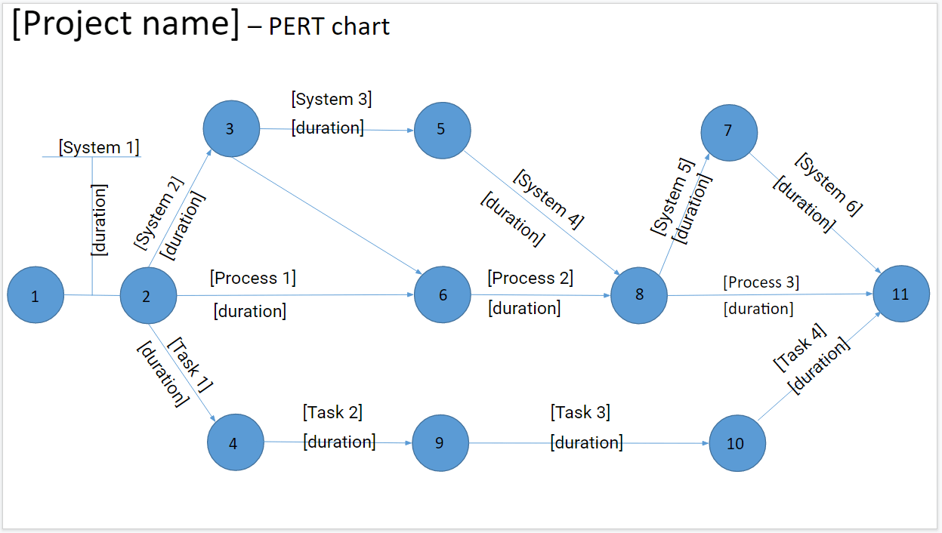
Instructions:
*READ THIS FIRST: Go to File, Make A Copy, and then fill out the template. Delete this message.
Add your project name
SYSTEMS:
Each system serves as a phase of the project (e.g. the phases may be the initiation, planning, execution and launch of the project)
Define your relevant systems, and their expected duration.
PROCESS:
Each system, i.e. phase, has several related processes (e.g. The execution phase may involve the processes of app design and app development)
Define your relevant processes, and their expected duration.
TASKS:
Each process has several related tasks to tackle.
Define your relevant tasks, and their expected duration.
PRODUCTIVITY TIP:
Track time with Clockify.me, to improve the estimations you’ll make about task durations

Slide 2
[Project name] – PERT chart
[System 3]
3
[duration]
5
7
[System 1]
[System 5]
[System 6]
[System 2]
[System 4]
[duration]
[duration]
[duration]
[duration]
[duration]
[Process 1]
[Process 2]
[Process 3]
1
2
6
8
11
[duration]
[duration]
[duration]
[Task 4]
[Task 1]
[duration]
[duration]
[Task 2]
[Task 3]
4
[duration]
9
[duration]
10

