Slide 1
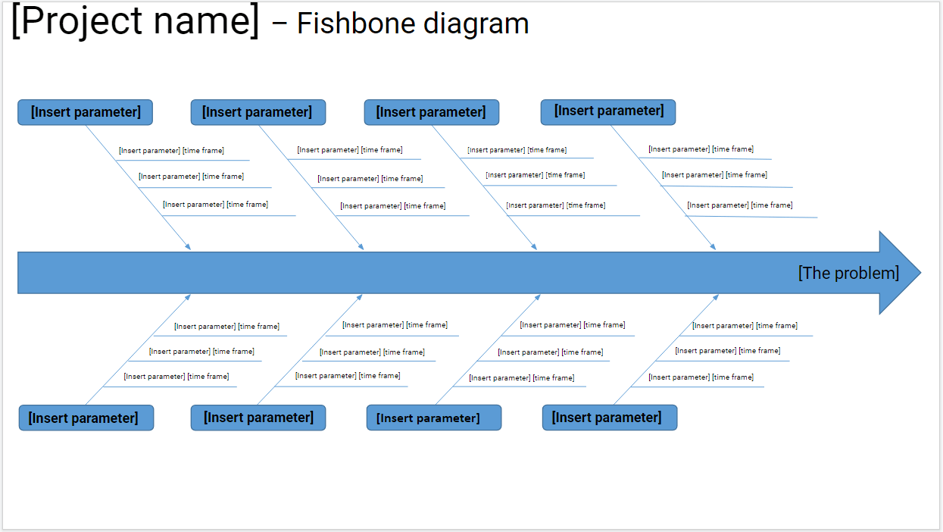
Instructions:
*READ THIS FIRST: Go to File, Make A Copy, and then fill out the template. Delete this message.
Add your project name
Define your main problem
MAIN PARAMETERS:
These are the main elements of your problem.
Define the main elements of your problem, in order to get a better grasp at how to solve it (e.g. This may be hiring additional staff to handle a specific project element causing the problem).
RELATED PARAMETERS:
These are the accompanying elements of your problem, and are related to the main parameters.
Define the accompanying elements of your problem (e.g. This may be the websites you’ll post your job offer to the additional staff you’ll need).
Define the time frame when you’ll focus on each (e.g. August 4th - August 10th; 9 am - 12 pm, August 10th).
PRODUCTIVITY TIP:
Track time with Clockify.me, to improve the estimations you’ll make about task durations

Slide 2
[Project name] – Fishbone diagram
[Insert parameter]
[Insert parameter]
[Insert parameter]
[Insert parameter]
[Insert parameter] [time frame]
[Insert parameter] [time frame]
[Insert parameter] [time frame]
[Insert parameter] [time frame]
[Insert parameter] [time frame]
[Insert parameter] [time frame]
[Insert parameter] [time frame]
[Insert parameter] [time frame]
[Insert parameter] [time frame]
[Insert parameter] [time frame]
[Insert parameter] [time frame]
[Insert parameter] [time frame]
[The problem]
[Insert parameter] [time frame]
[Insert parameter] [time frame]
[Insert parameter] [time frame]
[Insert parameter] [time frame]
[Insert parameter] [time frame]
[Insert parameter] [time frame]
[Insert parameter] [time frame]
[Insert parameter] [time frame]
[Insert parameter] [time frame]
[Insert parameter] [time frame]
[Insert parameter] [time frame]
[Insert parameter] [time frame]
[Insert parameter]
[Insert parameter]
[Insert parameter]
[Insert parameter]

